Slide 1
Faculty of Mathematics and Physics
Charles University
Game User Experience
Lecture 10

Slide 2
Practical info
Presentations 14.12.
Reporting – assignment
Emotions + Heuristics

Slide 3
Shared Document
Let‘s go to the g-doc https://docs.google.com/spreadsheets/d/1S224KOCIWKzA_WloW1wx3kx8IBXlc33VQ1ihAeZIDoY/edit?usp=sharing
(Link in the Discord)

Slide 4
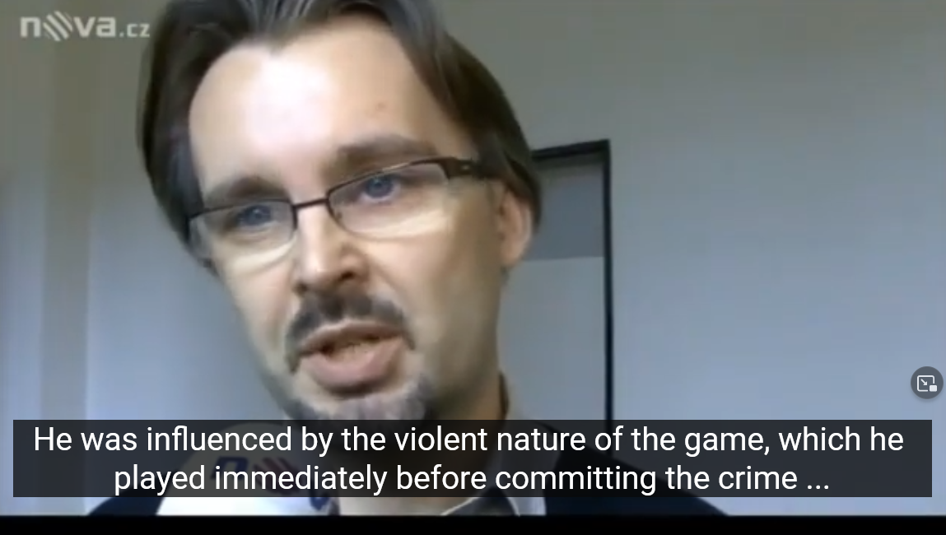
Public discourse
Střepiny (TV Nova, Youtube)

Slide 5
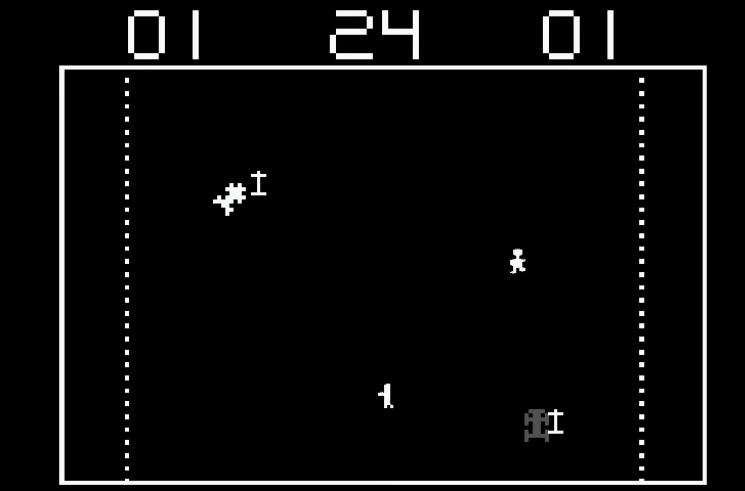
Moral panic
Death Race 2000 (Exidy, 1976)

Slide 6
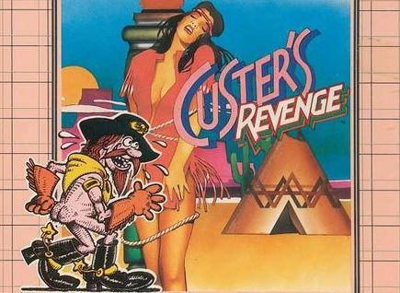
Moral panic
Custer‘s revenge (Mystique, 1982)

Slide 7
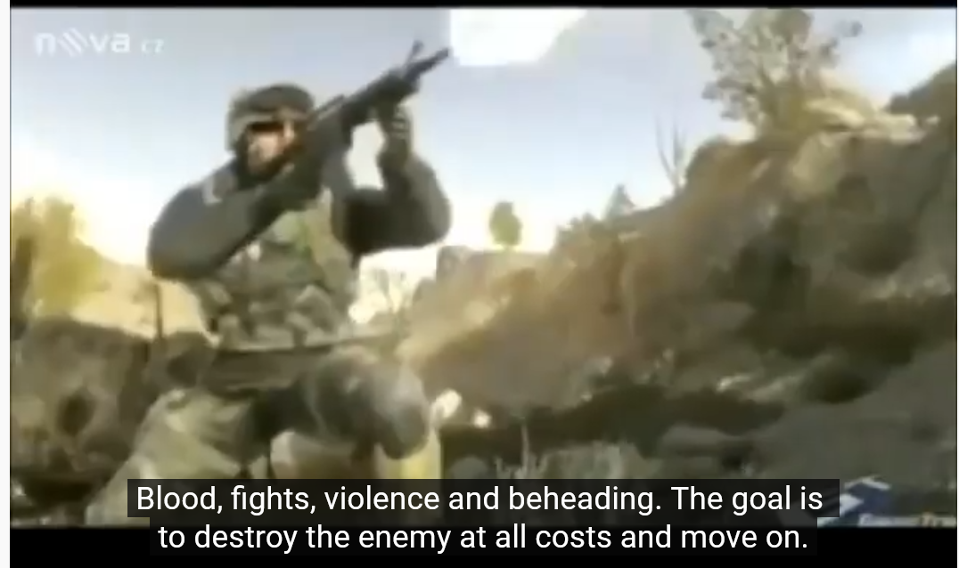
Violence & Aggressivity
Střepiny (TV Nova, Youtube)

Slide 8
Violence & Aggressivity
Violent games
-> contains violent actions committed by players or observed by players
Aggressivity -> Angry or violent feelings or behavior. Aggressive people do not necessarily act out with violence Violence -> physical force to intent to injure another person or destroy property
Střepiny (TV Nova,)
Source: Kowert, R. (2021)

Slide 9
Does playing violent games make players more aggressive?
Hundreds of studies on the topic (shared doc)
Notes:
It is a developers account – I am collecting data only from a certain population – probably gamers, somehow focused on some types of games
Response bias - where there’s something about how the actual survey questionnaire is constructed that encourages a certain type of answer, leading to measurement error.

Slide 10
Does playing violent games make players more aggressive?
Hundreds of studies on the topic
Only few confirmed the relation
Those few have limitations
Notes:
It is a developers account – I am collecting data only from a certain population – probably gamers, somehow focused on some types of games
Response bias - where there’s something about how the actual survey questionnaire is constructed that encourages a certain type of answer, leading to measurement error.

Slide 11
Effect on Aggression?
Abstract (…) We review 25 years of experimental, cross-sectional, longitudinal, and meta-analytical research in this field. Empirical evidence regarding the impact of violent digital games on player aggression is, at best, mixed and cannot support unambiguous claims that such games are harmful or represent a public health crisis.
Source:
Elson, M., & Ferguson, C. J. (2014). Twenty-five years of research on violence in digital games and aggression: Empirical evidence, perspectives, and a debate gone astray. European Psychologist, 19(1), 33–46. https://doi.org/10.1027/1016-9040/a000147
Notes:
It is a developers account – I am collecting data only from a certain population – probably gamers, somehow focused on some types of games
Response bias - where there’s something about how the actual survey questionnaire is constructed that encourages a certain type of answer, leading to measurement error.

Slide 12
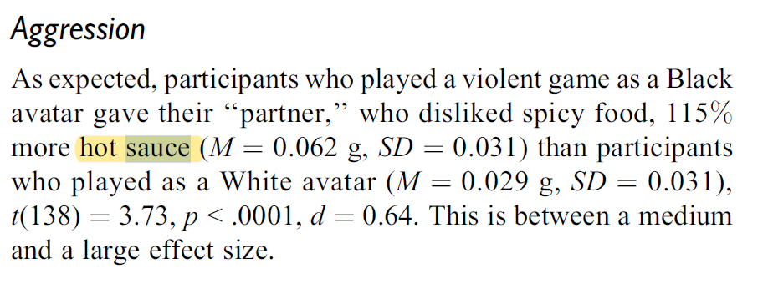
Measurements
Yang, G. S., Gibson, B., Lueke, A. K., Huesmann, L. R., & Bushman, B. J. (2014). Effects of Avatar Race in Violent Video Games on Racial Attitudes and Aggression. Social Psychological and Personality Science, 5(6), 698–704. https://doi.org/10.1177/1948550614528008
Notes:
It is a developers account – I am collecting data only from a certain population – probably gamers, somehow focused on some types of games
Response bias - where there’s something about how the actual survey questionnaire is constructed that encourages a certain type of answer, leading to measurement error.

Slide 13
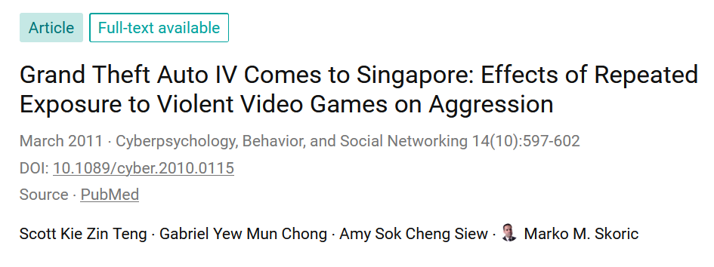
Measurements
Notes:
It is a developers account – I am collecting data only from a certain population – probably gamers, somehow focused on some types of games
Response bias - where there’s something about how the actual survey questionnaire is constructed that encourages a certain type of answer, leading to measurement error.

Slide 14

Effect on violence?
Does playing violent games make someone more violent or do violent actions?
No
Notes:
It is a developers account – I am collecting data only from a certain population – probably gamers, somehow focused on some types of games
Response bias - where there’s something about how the actual survey questionnaire is constructed that encourages a certain type of answer, leading to measurement error.

Slide 15
Effect on violence?
Does playing violent games make someone more violent or do violent actions?
No
Notes:
It is a developers account – I am collecting data only from a certain population – probably gamers, somehow focused on some types of games
Response bias - where there’s something about how the actual survey questionnaire is constructed that encourages a certain type of answer, leading to measurement error.

Slide 16
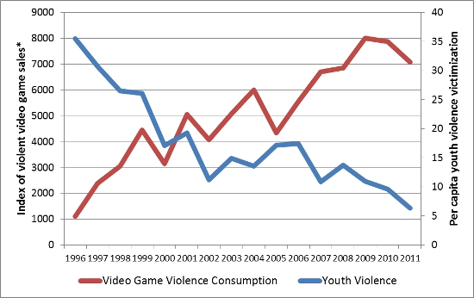
Violent game & violent crimes
Source: Ferguson, C.,J. (LSE, 2014)
Notes:
It is a developers account – I am collecting data only from a certain population – probably gamers, somehow focused on some types of games
Response bias - where there’s something about how the actual survey questionnaire is constructed that encourages a certain type of answer, leading to measurement error.

Slide 17
Effects on desensitization
Desensitization
-> Process diminishing emotional responsiveness to a negative, aversive or positive stimulus after repeated exposure to it
Two approaches
Normalization of violence
Discharge of aggression
Střepiny (TV Nova,)
Source: Kowert, R. (2021)

Slide 18

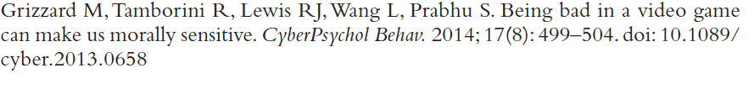
Effects on desensitization
Střepiny (TV Nova,)

Slide 19

Guilt & Video Games
Spec Ops, The Line (YAGER, 2012)

Slide 20
Effect on desensitization?
Does playing violent games make someone more violent or do violent actions?
No
Notes:
It is a developers account – I am collecting data only from a certain population – probably gamers, somehow focused on some types of games
Response bias - where there’s something about how the actual survey questionnaire is constructed that encourages a certain type of answer, leading to measurement error.

Slide 21
Faculty of Mathematics and Physics
Charles University
Part one is over
Stay in touch on Discord
Notes:
And for the obligatory Joke of the Day!
(click)
What’s the object-oriented way to become wealthy?
Inheritance of course!

